Slide 1
Chapter 5 Confidence Interval
Speaker : H.M. Liang

Slide 2
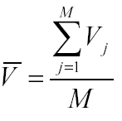
Background
Why confidence interval is necessary?
  Suppose M replications in simulation
  V₁, V₂, V₃, …,V_{m}
Can we trust the experimental results?

Slide 3
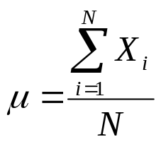

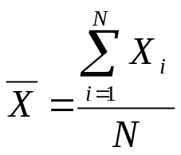
Background
Population
Sample
μ, population mean
,Sample mean

Slide 4

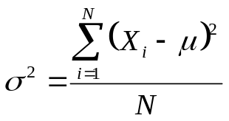

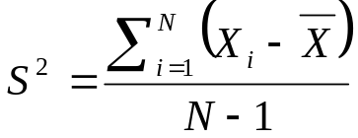
Background
,variance
,sample variance

Slide 5

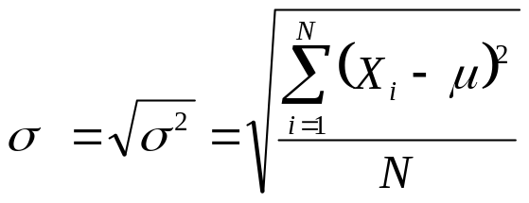
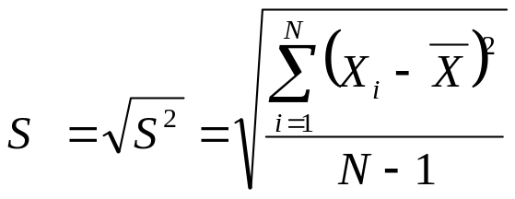
Background
,standard deviation
S ,sample standard deviation

Slide 6

Background – Central Limit Theorem
Let X₁, X₂, …, X_{n} be IID random variables with finite meanμ and finite variance
Let Z_{n} be the random variable [ _{(n)} - μ] /
Let F_{n}(z) be the distribution function of Z_{n} for a sample size of n
Note μ and /n are the mean and variance of _{(n)}

Slide 7
Background – Central Limit Theorem
Theorem
  F_{n}(z) →Ǿ(z) as n →∞, where Ǿ(z) , the distribution function of a normal random variable with μ = 0 and =1
  The theorem says, in effect, that if n is “sufficiently large,” the random variable Zn will be approximately distributed as a standard normal random variable, regardless of the underlying distribution of the X’s
  It can also be shown for large n that the sample mean (n)
  is approximately distributed as a normal random variable
  with mean μ and variance /n

Slide 8
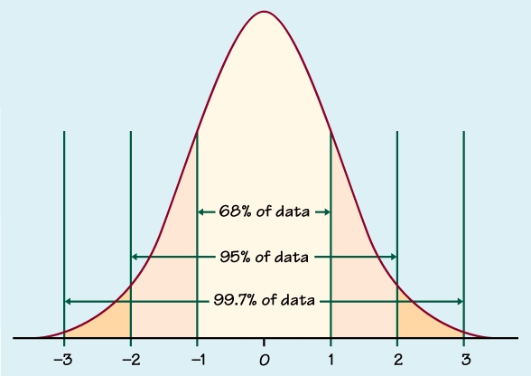
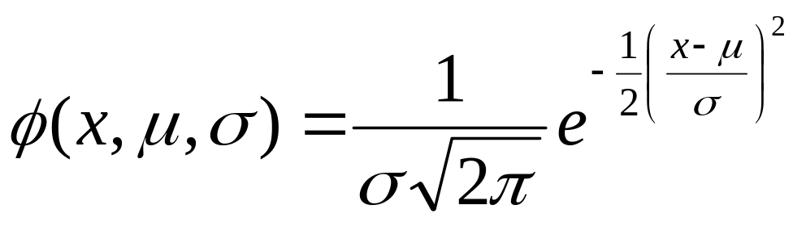
The normal density
The height of the normal density curve for the normal distribution with mean μ and SD σ is given by:
Why is the normal distributions important?
  Good description for some distributions of real data. (e.g. test scores, repeated measurements, characteristics of biological populations, etc.)
  Good approximations to the results of many kinds of chance outcomes. (e.g. coin tossing).
  Many statistical inference procedures based on normal distributions work well for other roughly symmetric distributions.

Slide 9
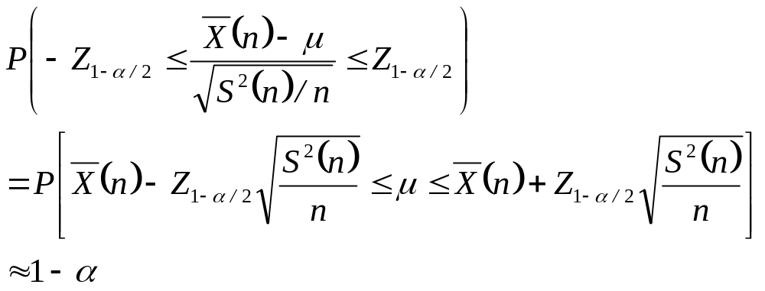
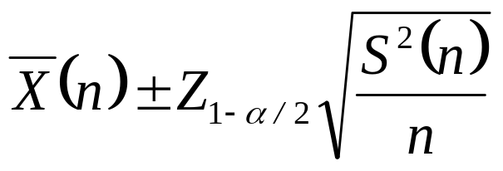
Background – Central Limit Theorem
Therefore, if n is sufficiently large, an approximate 100(1-α)
percent confidence interval for μ is given by

Slide 10
Background – Confidence Interval
Confidence Level (%) | α | α/2 | Z_{1-α/2}
20 | 0.8 | 0.4 | 0.253
40 | 0.6 | 0.3 | 0.524
60 | 0.4 | 0.2 | 0.842
68.26 | 0.3174 | 0.1587 | 1.000
80 | 0.2 | 0.1 | 1.282
90 | 0.1 | 0.5 | 1.645
95 | 0.05 | 0.025 | 1.960
95.46 | 0.0454 | 0.0228 | 2.000
98 | 0.02 | 0.01 | 2.326
99 | 0.01 | 0.005 | 2.576
99.74 | 0.0026 | 0.0013 | 3.000
99.8 | 0.002 | 0.001 | 3.090
99.9 | 0.001 | 0.0005 | 3.29
99.98 | 0.0002 | 0.0001 | 3.72

Slide 11
80% confidence level
Standard normal
distribution curve
P = (1-0.8)/2=0.1
Probability = 0.1
P = 0.8
− 1.28
0
z*=1.28

Slide 12
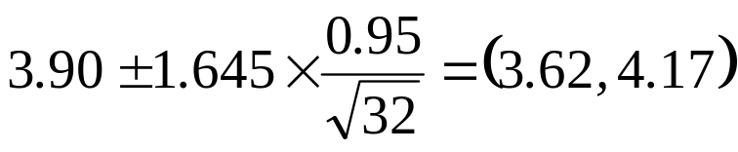
Background – Confidence Interval
Suppose =3.90, standard deviation S=0.85, sample size N =32
90% confidence interval is

Slide 13
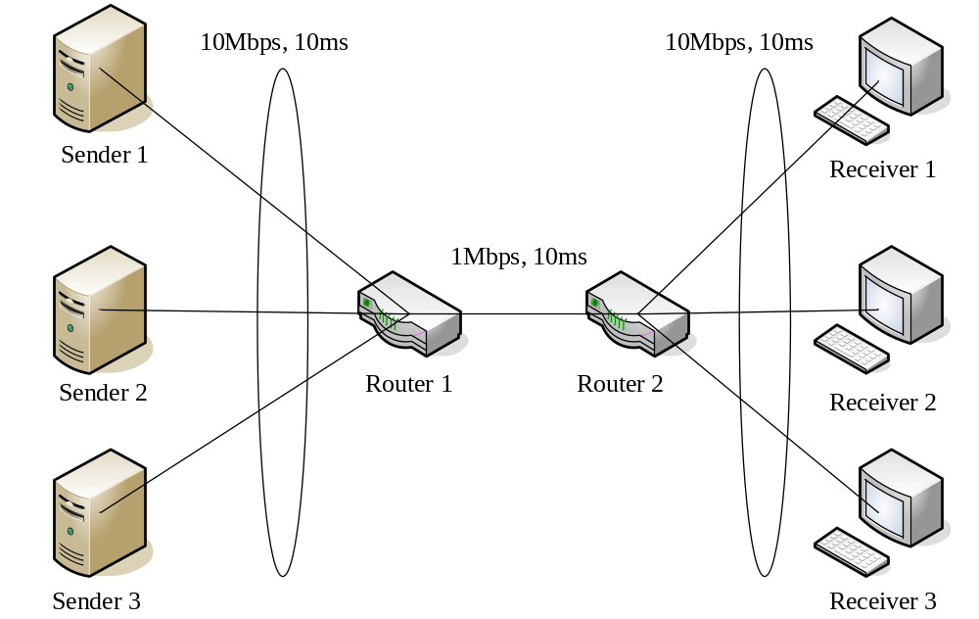
Example

